Slide 1
Pre-Assessment Questions
1. Which languages use the procedural programming methodology?
  a. Pascal, Java
  b. FORTRAN, C
  c. C, Java
  d. Pascal, C
2. Which language uses the simple sequential programming methodology?
  a. C
  b. Java
  c. FORTRAN
  d. Pascal
Java Fundamentals
Lesson 1B / Slide <number> of 29

Slide 2
Pre-Assessment Questions (Contd.)
3. What is the acronym for OOP?
  a. Object Oriented Programming
  b. Object Orientation programming
  c. Object Oriented Program
  d. Object Oriented Procedure
4. The acronym for the procedural language COBOL is -----------------------------.
a. Common Object Business Oriented Language
b. COmmon Business Oriented Language
c. Common Object Business Object Language
d. Common Object Business Optimized Language
Java Fundamentals
Lesson 1B / Slide <number> of 29

Slide 3
Pre-Assessment Questions (Contd.)
5. Which language is a Object Oriented Programming language?
Basic
COBOL
Java
C
Java Fundamentals
Lesson 1B / Slide <number> of 29

Slide 4
Solutions to Pre-Assessment
Questions
d. Pascal, C
c. FORTRAN
a. Object Oriented Programming
b. COmmon Business Oriented Language
c. Java
Java Fundamentals
Lesson 1B / Slide <number> of 29

Slide 5
Objectives
  In this lesson, you will learn to:
    Identify the features of object-oriented programming
      Encapsulation
      Abstraction
      Inheritance
      Polymorphism
Java Fundamentals
Lesson 1B / Slide <number> of 29

Slide 6

Features of Object-Oriented Programming
  Encapsulation
    Grady Booch, defined the encapsulation feature as:
    “Encapsulation is the process of hiding all of the details of an object that do not contribute to its essential characteristics.”
    Encapsulation is the feature that provides security to the data as well as the methods of a class.
Java Fundamentals
Lesson 1B / Slide <number> of 29

Slide 7
Features of Object-Oriented Programming(Contd.)
  Abstraction
    Grady Booch defined the encapsulation feature as:
    “An Abstraction denotes the essential characteristics of an object that distinguishes it from all other kinds of objects and thus provides crisply defined conceptual boundaries, relative to the perspective of the viewer.”
    Abstraction refers to the attributes of an object that clearly demarcates it from other objects.
    The concept of abstraction is implemented in object-oriented programming by creating classes.
  Encapsulation hides the irrelevant details of an object and abstraction makes only the relevant details of an object visible.
Java Fundamentals
Lesson 1B / Slide <number> of 29

Slide 8
Features of Object-Oriented Programming(Contd.)
  Inheritance:
    Enables you to extend the functionality of an existing class.
    Enables you to add new features and functionality to an existing class without modifying the existing class.
    Enables you to share data and methods among multiple classes.
Java Fundamentals
Lesson 1B / Slide <number> of 29

Slide 9
Features of Object-Oriented Programming(Contd.)
    Superclass and Subclass
      A superclass or parent class is the one from which another class inherits attributes and behavior.
      A subclass or child class is a class that inherits attributes and behavior from a superclass.
Java Fundamentals
Lesson 1B / Slide <number> of 29

Slide 10
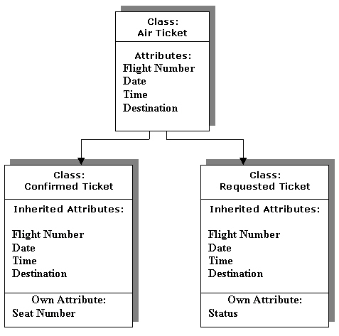
Features of Object-Oriented Programming(Contd.)
Java Fundamentals
Lesson 1B / Slide <number> of 29

Slide 11
Features of Object-Oriented Programming(Contd.)
    Relationships Between Classes
      Kind-of
      Is-a
      Part-of
      Has-a
Java Fundamentals
Lesson 1B / Slide <number> of 29

Slide 12
Features of Object-Oriented Programming(Contd.)
      Kind-of
        A subclass always inherits the attributes of the superclass.
Ticket
Confirmed
Ticket
Kind-of
Java Fundamentals
Lesson 1B / Slide <number> of 29

Slide 13
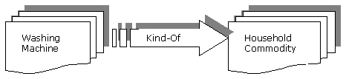
Features of Object-Oriented Programming(Contd.)
      Kind-of (Contd.)
        Washing machine is a kind of household commodity and depicts the kind-of relationship.
Java Fundamentals
Lesson 1B / Slide <number> of 29

Slide 14
Features of Object-Oriented Programming(Contd.)
      Is-a Relationship
        Relationship between objects of superclass and subclass is referred to as an is-a relationship.
Confirmed
Ticket
Ticket
Ticket for
New York
Is-A
Kind of
Is-A
Java Fundamentals
Lesson 1B / Slide <number> of 29

Slide 15
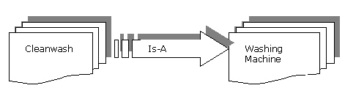
Features of Object-Oriented Programming(Contd.)
      Is-a Relationship (Contd.)
        The is-a relationship between the Cleanwash class and Washing Machine class.
Java Fundamentals
Lesson 1B / Slide <number> of 29

Slide 16
Features of Object-Oriented Programming(Contd.)
      Part-of Relationship
        When a class is an element of another class, it depicts the part-of relationship.
Address
Student
Part of
Java Fundamentals
Lesson 1B / Slide <number> of 29

Slide 17
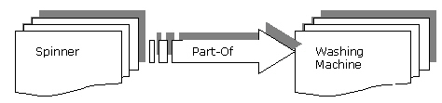
Features of Object-Oriented Programming(Contd.)
      Part-of Relationship (Contd.)
        A spinner being a part of washing machine depicts the part-of relationship between the spinner and the washing machine class.
Java Fundamentals
Lesson 1B / Slide <number> of 29

Slide 18
Features of Object-Oriented Programming(Contd.)
      Has-a Relationship
        Is reverse of the part-of relationship.
        The has-a relationship is also known as aggregation or composition.
Student
Detail
Has-a
Address
Java Fundamentals
Lesson 1B / Slide <number> of 29

Slide 19

Features of Object-Oriented Programming(Contd.)
      Has-a Relationship (Contd.)
        A washing machine has a spinner and depicts the has-a relationship between the Washing Machine and Color class.
Java Fundamentals
Lesson 1B / Slide <number> of 29

Slide 20
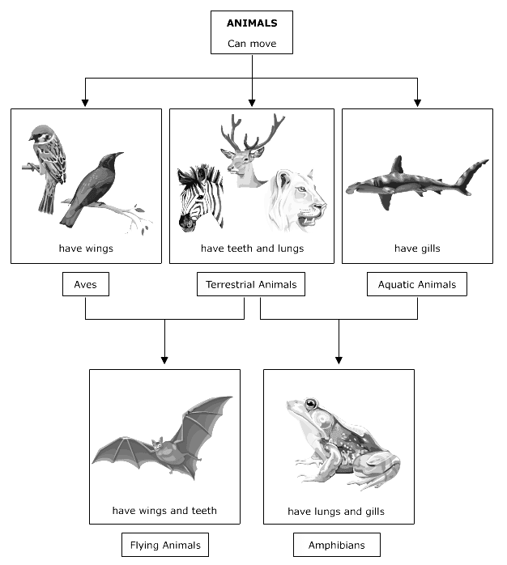
Features of Object-Oriented Programming(Contd.)
      Types of Inheritance
Java Fundamentals
Lesson 1B / Slide <number> of 29

Slide 21
Features of Object-Oriented Programming(Contd.)
      Types of Inheritance (Contd.)
        Single inheritance
        Multiple inheritance
Java Fundamentals
Lesson 1B / Slide <number> of 29

Slide 22
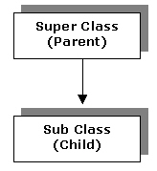
Features of Object-Oriented Programming(Contd.)
      Types of Inheritance(Contd.)
        Single inheritance
        Subclass is derived from only one superclass.
Java Fundamentals
Lesson 1B / Slide <number> of 29

Slide 23
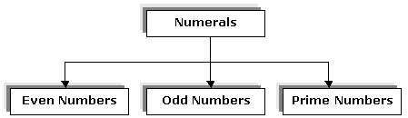
Features of Object-Oriented Programming(Contd.)
      Types of Inheritance (Contd.)
        Single inheritance
Java Fundamentals
Lesson 1B / Slide <number> of 29

Slide 24
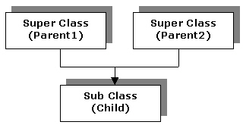
Features of Object-Oriented Programming(Contd.)
      Types of Inheritance(Contd.)
        Multiple inheritance
        A subclass is derived from more than one super class.
Java Fundamentals
Lesson 1B / Slide <number> of 29

Slide 25
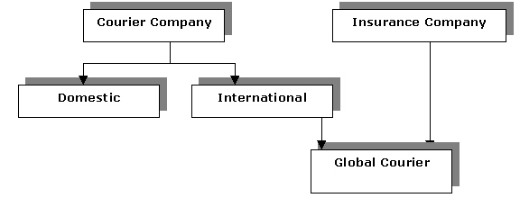
Features of Object-Oriented Programming(Contd.)
      Types of Inheritance (Contd.)
        Multiple inheritance
Java Fundamentals
Lesson 1B / Slide <number> of 29

Slide 26
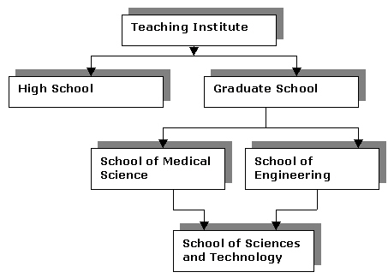
Features of Object-Oriented Programming(Contd.)
      Types of Inheritance (Contd.)
        Multiple inheritance
Single
Inheritance
Multiple
Inheritance
Java Fundamentals
Lesson 1B / Slide <number> of 29

Slide 27
Features of Object-Oriented Programming(Contd.)
  Polymorphism
    Derived from two Latin words-Poly, which means many, and morph, which means forms.
Java Fundamentals
Lesson 1B / Slide <number> of 29

Slide 28
Summary
  In this lesson, you learned:
    Encapsulation- Hides the implementation details of an object and therefore hides its complexity.
    Abstraction- Focuses on the essential features of an object.
    Inheritance- Creates a hierarchy of classes and helps in reuse of attributes and methods of a class.
    The relationship among the classes can be classified as:
      Kind-of
      Is-a
      Part-of
      Has-a
    A superclass shares its attributes and behavior with its child classes.
    A subclass inherits its attributes and behavior from parent classes.
Java Fundamentals
Lesson 1B / Slide <number> of 29

Slide 29
Summary(Contd.)
    There are two types of inheritance:
      Single inheritance- A class inherits attributes from only one superclass.
      Multiple inheritance- A class inherits attributes from two or more superclasses.
    Polymorphism- Assigns a different meaning or usage to an entity in different contexts.
Java Fundamentals
Lesson 1B / Slide <number> of 29

